Slide 1
CS50 Lab 8 Andrew Holmes

Slide 2
Useful info
Tutorial time
5-6pm Pfoho dhall (can be hybrid, email me if needed)
Email
aholmes@college.harvard.edu
Slack

Slide 3
Today’s Logistics
HTML
CSS

Slide 4
Structs.c
Practice with structs and arrow notation :)
Structs.c in your email
Team up!

Slide 5
JS: DOM Elements
.getElementById
.querySelector
.querySelectorAll

Slide 6
JS: Event Listeners
<DOM_ELT>.addEventListener(<event>, <fun>)
This creates an ‘event listener’ attached to this DOM element, every time <event> is detected at this element, it executes <fun>.
button.addEventListener(‘click’, function() {alert(‘clicked!’)})

Slide 7
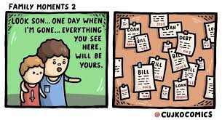
Lab problem: inheritance
https://cs50.harvard.edu/college/2022/fall/labs/5/

Slide 8
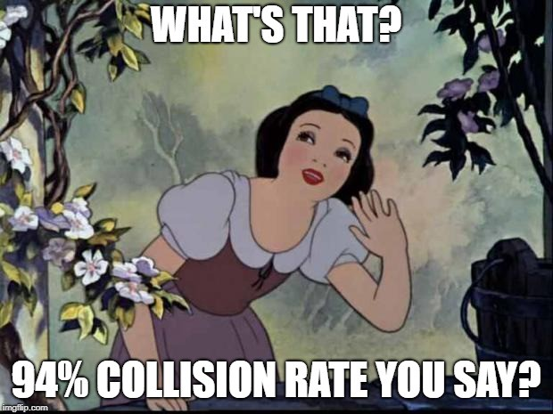

Slide 9
Other speed improvements
Perhaps one of the other data structures mentioned in section may improve efficiency vs linked list?
Recursive vs iterative speed
What does the dream hash table look like? Could we achieve this (answer: yes – it’s very hard though!)

Slide 10
PSET 5 pointers
Speller:
Hash function: make sure your function at least USES every letter in the string to calculate the hash value.
Lots of arrow notation ☺
Remember to free all nodes and close files!
Strcpy may be useful, but is there a way to handle load without using it?

Slide 11

Cya next week :D TIME FOR A NEW LANGUAGE!

